Slide 1

OLYMPICS MANAGEMENT SYSTEM
Team Members
HARSH RAJ (1SG15CS028)
KAMAD BHATT (1SG15CS036)
MD. ADNAN AHMED (1SG15CS050)
MOHIT KUMAR (1SG15CS054)
Notes:
o

Slide 2
Contents
Project Objective
Software Requirements
End users
Methods
Flowchart Diagram
Future Enhancement
Reference

Slide 3
Project Objective
This project is focused on planning and organization of the games, so it is named “ Olympics Management System”.
Here, we can add/delete a new player, schedule or result, update information , view and manage players, check the details of an existing athlete, remove existing information and view players’ list.
Overall, with this project, you can perform activities like in a REAL Olympics game.

Slide 4
Introduction
Olympic management systems are designed to manage the events in an organized way.
Olympic games are held every four years and there is a considerable amount of information to be maintained.
An effective management is utmost necessary for the events to take place.

Slide 5
What we learnt?
Technical learning
HTML
Javascript and CSS
Use of wamp server
PHP Programming
General learning
Team work

Slide 6
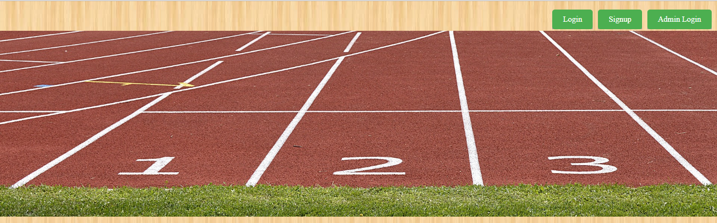
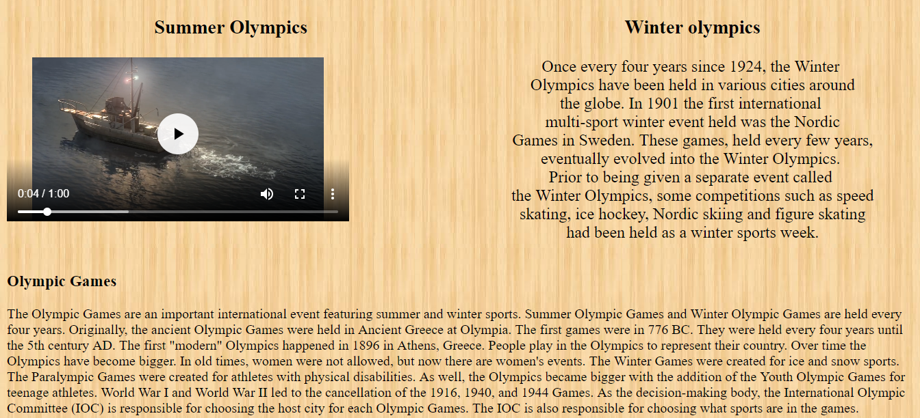
Methods
We created a database as Olympics in MySQL.HTML was used for designing.
Fig 1:Home Page

Slide 7

Fig 2:Admin Login
This is the page for admin login. Once we enter root as both username and password, one can get super privileges.

Slide 8

Fig 3:User Login
This is the page for user login. Once one has signed up, he can be an user.

Slide 9
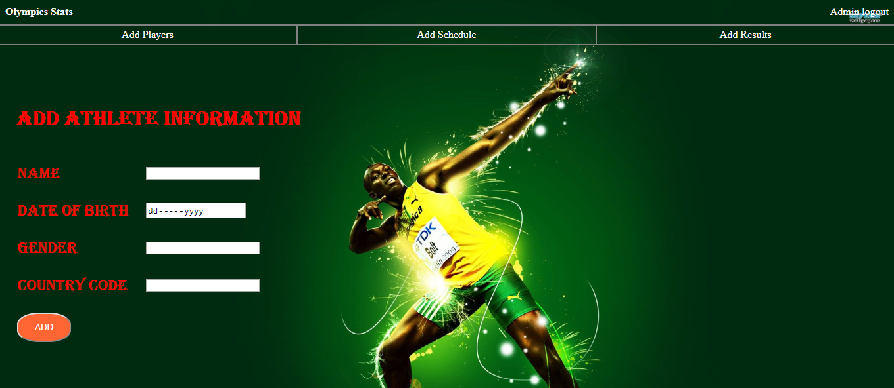
Fig 4:Adding information
Only the admin has the privilege to add an athlete , a schedule or a result. This is done on the above page.

Slide 10
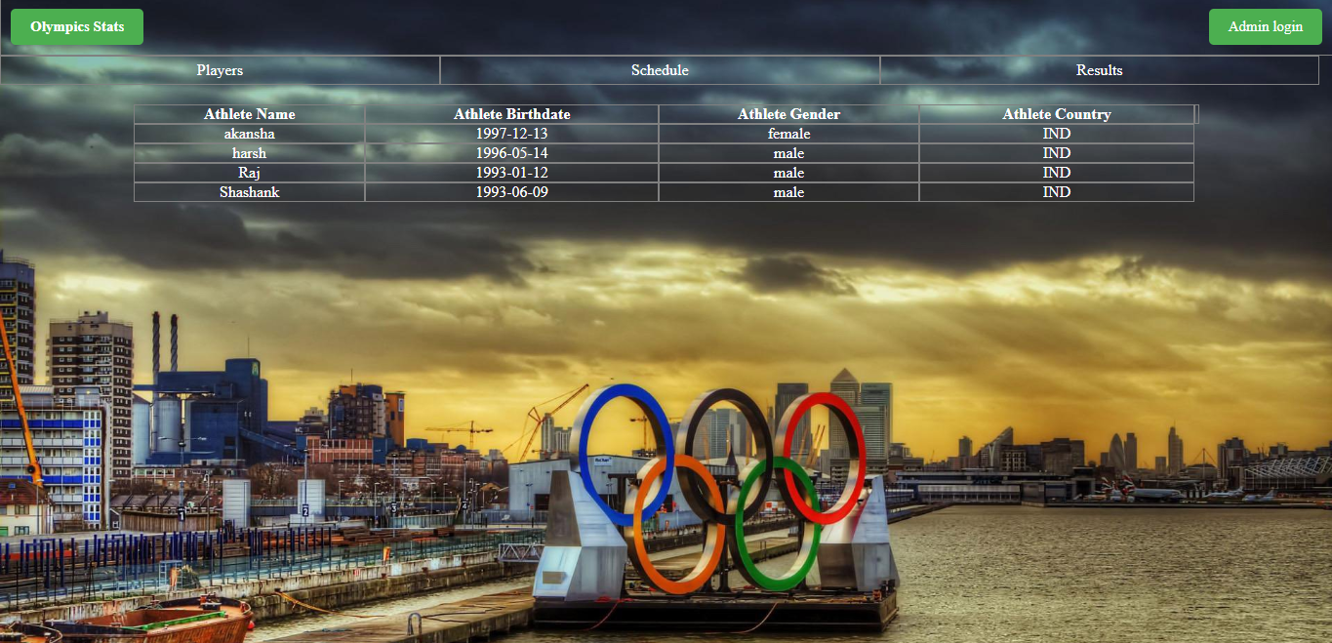
Fig 5:Viewing and deleting of information
Once the admin has entered the details, it is visible.
The admin can also delete a particular information.

Slide 11
End Users
Professional Olympic Athletes
Professional managers
Professional event authorities

Slide 12
Software Requirements
HTML, Javascript
Wamp Server
Web Browser

Slide 13
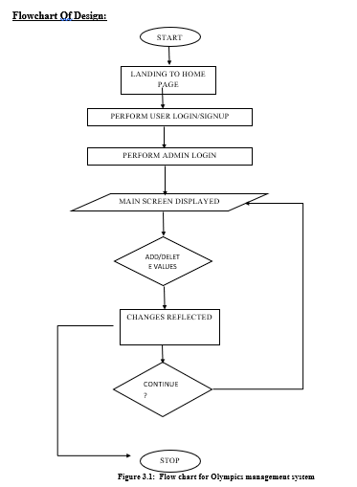
Flowchart Diagram

Slide 14
Future Enhancements:-
More data storage
Better graphical interface
Back end maintenance support

Slide 15
Reference
https://www.w3schools.com
https://www.google.com
https://www.wikipedia.com

Slide 16
THANK YOU

